Slide 1
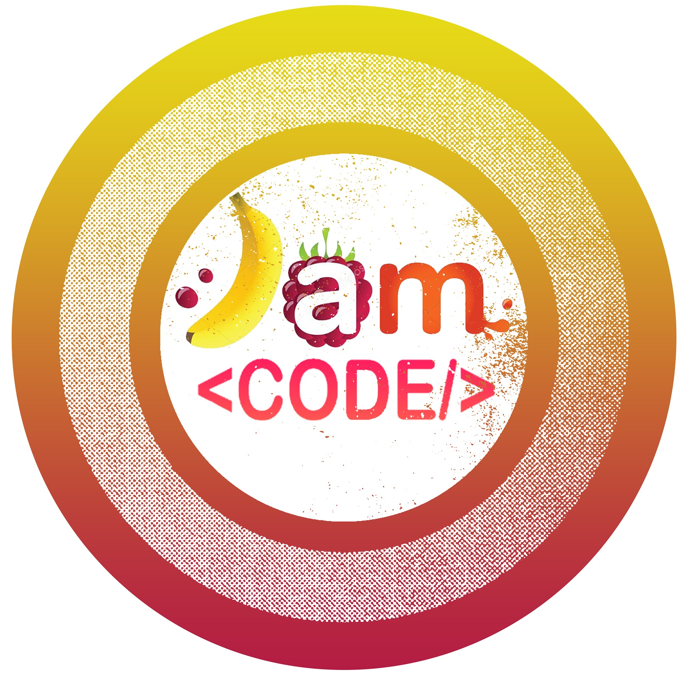

Serialization in Java
Serialization in Java

Slide 2


What are serialization & Deserialization in Java?
Serialization
Serialization is a mechanism to convert an object into stream of bytes so that it can be written into a file, transported through a network, or stored into database.
De-serialization
De-serialization is just a vice versa. In simple words serialization is converting an object to stream of bytes and de-serialization is rebuilding the object from stream of bytes.
Source: BeginnersBook.com

Slide 3
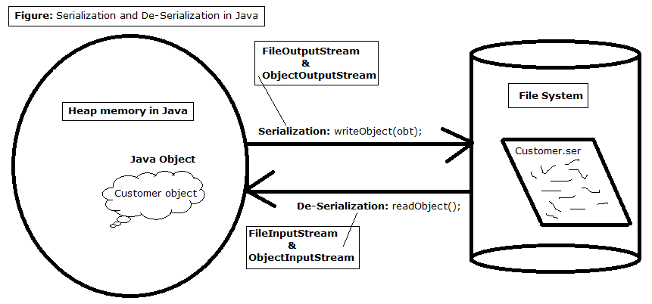
Source: BenchSources.net

Slide 4

Serialization in Java
Java Serialization
Java object serialization

Slide 5

Serialization in Java
Object Serialization in Java | Serialization Interface
Java - Serialization & Deserialization
Notes:
Object Serialization in Java | Serialization Interface (general ideas of serialization and deserialization - talked about advantages and disadvantages)
I really like this video on Java - Serialization & Deserialization. She is quite good at explaining and good example with our 20Q game.

Slide 6

Notes:
Object Serialization in Java | Serialization Interface (general ideas of serialization and deserialization - talked about advantages and disadvantages) Good introduction and discussion
I really like this video on Java - Serialization & Deserialization. She is quite good at explaining and good example with our 20Q game.

Slide 7
Thank You

